Slide 1

For students. By students.

Slide 2
OVERVIEW
A platform where students organize all their needs at one place.
They will be connected to entrepreneurs all over the world.
Students would place his/her idea, impress the entrepreneurs and thus turn their ideas into a reality.
IT’S YOUR LIFE , MAKE IT LARGE
….or someone else would hire you to make theirs.

Slide 3
PROBLEM
Struggle of Students

Slide 4
What is the problem?
No one stop solution for students to look at.
Complexity of tools.
Lack of availability of student resources.
Risk of failure , public fear , financial problems and loss of self confidence due to which students can’t openly discuss their unique ideas and get guidance to implement it.

Slide 5
SOLUTION
Bringing order to a chaos

Slide 6
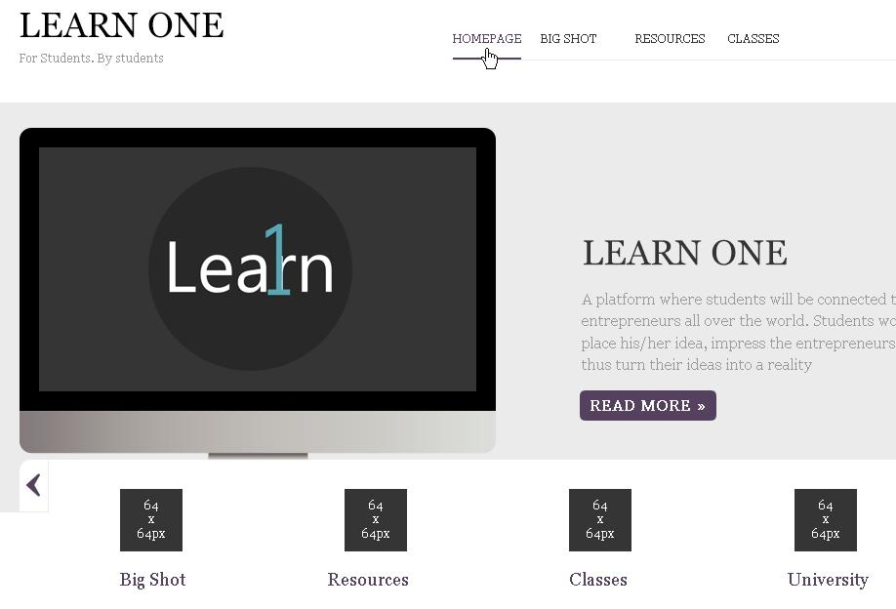
SOLUTION
One platform to access all study resources.
Guidance or support via one to one communication with entrepreneurs and successful people in the area of interest.
Helps students to test themselves and choose a perfect field of their interest.

Slide 7
HOW IT WORKS

Slide 8
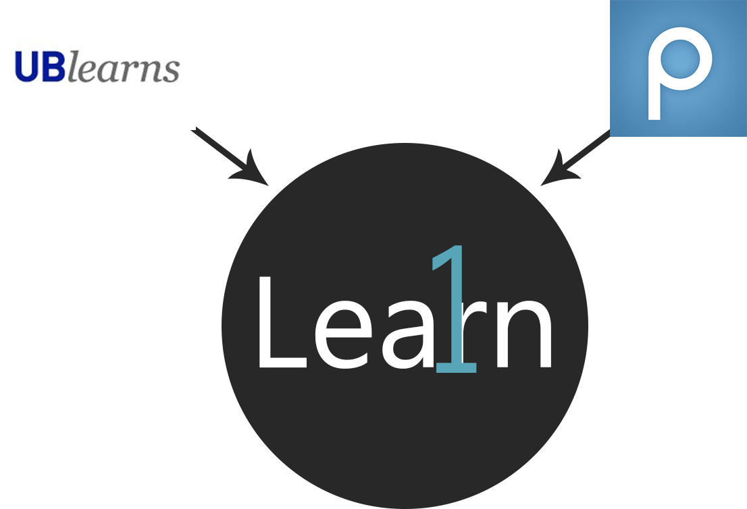
IDEA
LEARN ONE
NOT JUST
UBLearns
BIG SHOT
Piazza
Book Swaps

Slide 9
EVERYTHING IS EASY AND AT ONE PLACE

Slide 10
{MAIN FEATURES}

Slide 11

STUDENT
List of resources available for student -
Online classes
Lecture videos
BigShot
Downloadable(Licensed) Softwares.
Book Swapping
Logs in to Learn one

Slide 12
COMPETITIVE ADVANTAGE

Slide 13
Competitive Advantages
More features at ONE PLACE -
Textbook exchange using geo location.
“BigShot” is a UNIQUE Feature - communication with entrepreneurs online.
Ability to view tutorials/content from all subjects (not just ones you’re enrolled in).
Tutorials/Materials from multiple sources.
How to Sustain Advantages? Keep increasing amount of study/tutorial material and keep adding expertise to “BigShot” feature.
Functionality convenient options for the students Cost Effective -> Potentially
MORE

Slide 14
TARGET CUSTOMERS

Slide 15

Target Customers
STUDENTS - intended users of LearnOne.
Industry/Companies - partnership with industry professionals to provide students with “BigShot”.
Universities - Intended consumers: purchase software and provide to students as part of their annual fees.
Market Attractiveness? Very attractive -> no added fee to the students (surveys = students prefer LearnOne)

Slide 16
CUSTOMER VALIDATION

Slide 17
Customer Value Proposition
Question arises, why customer will use our product?
As mentioned, our target customers are the students. According to the polls (online survey) conducted - More than 50% students are not satisfied with what they have right now.
We are trying to provide what they asked for - CONVENIENCE.

Slide 18
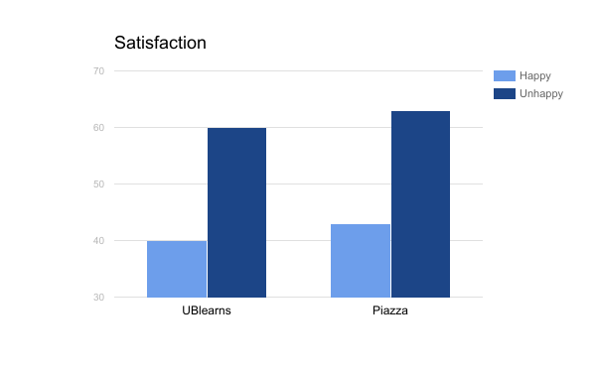
Customer Learnings - Survey Results

Slide 19
MARKET
e-learning

Slide 20
45%
People use mobile apps for day to day interaction.
And prefer mobile communication.

Slide 21
$30 billion
Mobile industry market size by the end of 2017

Slide 22
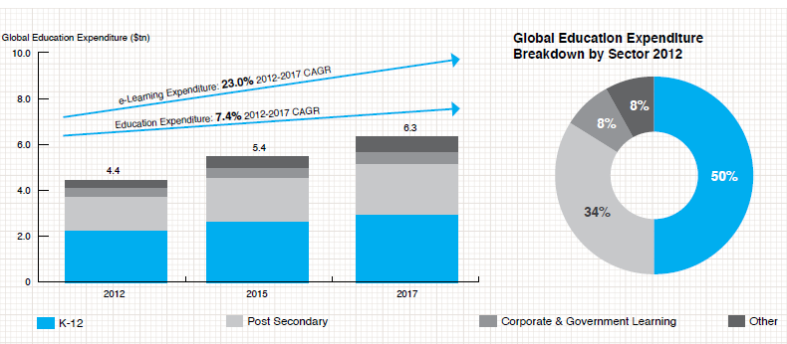
e-learning market size increasing the past few years

Slide 23
COMPETITORS

Slide 24



Competition
UBlearns, Piazza, Blackboard and other campus portal platforms.
BigShot - Clarity, SmartUp

Slide 25
Competitors Shortcomings
Not a one-stop-shop solution as required by students, quite generic.
Poor to no mobile support for the platform.
SmartUp requires to play in-app and accumulate 1000 in-app points before the users can get to ask the entrepreneurs with their queries.

Slide 26
BUSINESS MODEL

Slide 27
How we earn
Yearly packages - Given to universities at lower rates to generate yearly revenue. Starts by end of 2017
Universities pay us, not the students
Free for students.
In-app purchases - Two or more mentors on “BigShot”.
Students can go for GOLDEN purchases.
Can have multiple mentors for same field.

Slide 28
Revenue model
Better utilization of Technology Fee
Revenue growth -
UB @ moment
University pay 90%
pay
LEARN ONE
University
Total using fee
Student pay 10% (part of tuition bill)

Slide 29
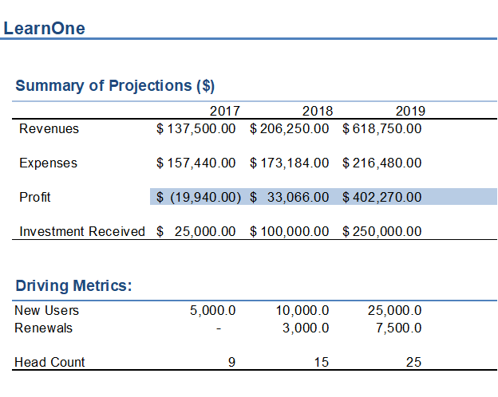
Financial
Notes:
Revenues just university
Expenses all cost
Profit
Investment just the money come from investment company for 25k

Slide 30
FINANCIAL PROJECTIONS

Slide 31
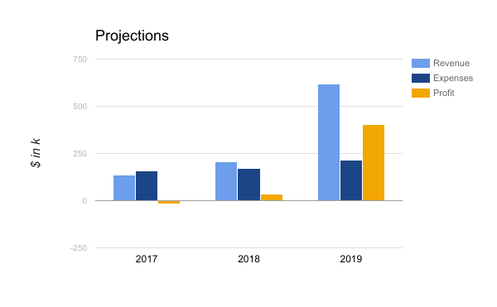
Financial
Financial Projections

Slide 32
$400k
Profit by end of 2019.
Just by taking UB as our source of income.

Slide 33
NUMBERS - BY 2018

Slide 34
Current status and milestones
15,000
Users by
2018

Slide 35
Current status and milestones
200+
Entrepreneurs
20+
Universities

Slide 36
INVESTMENT

Slide 37
$25k
Seed investment we are looking for.

Slide 38
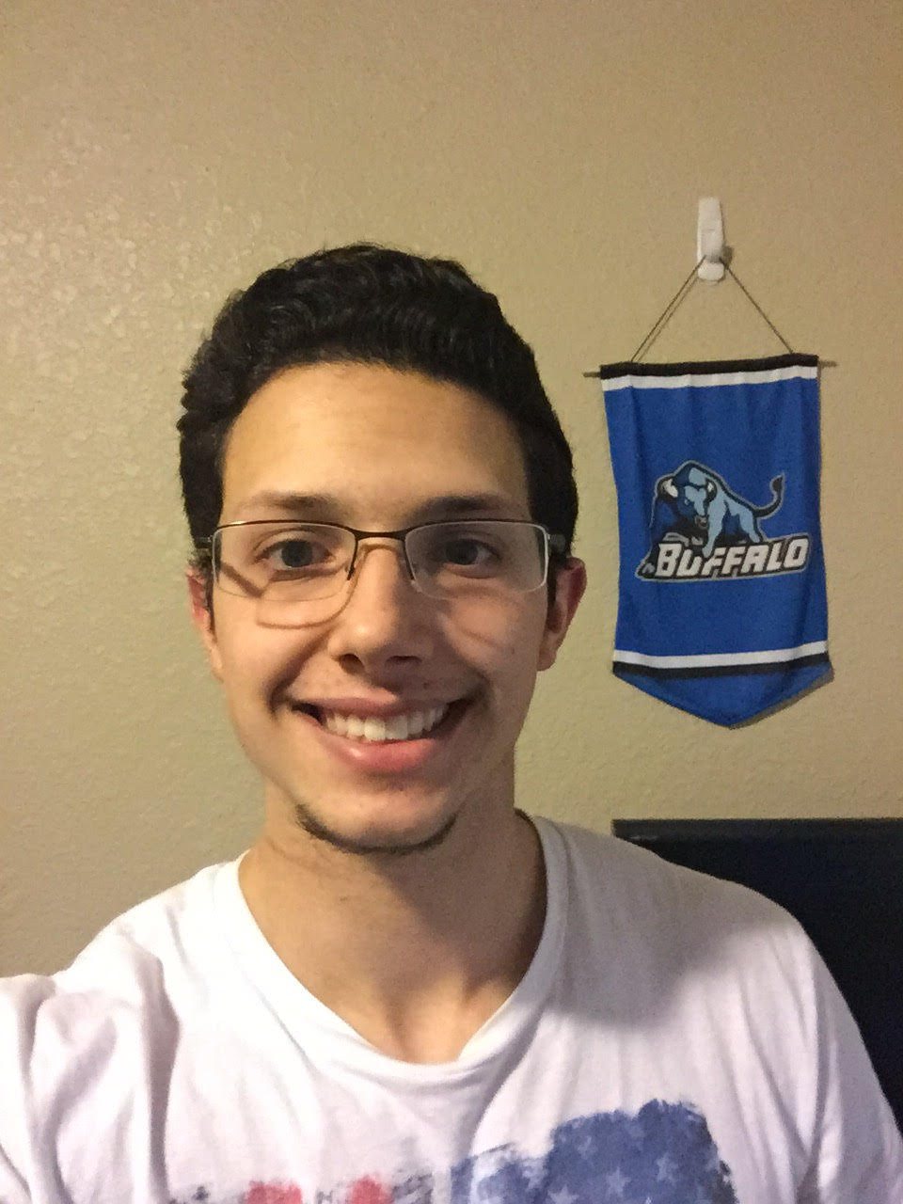

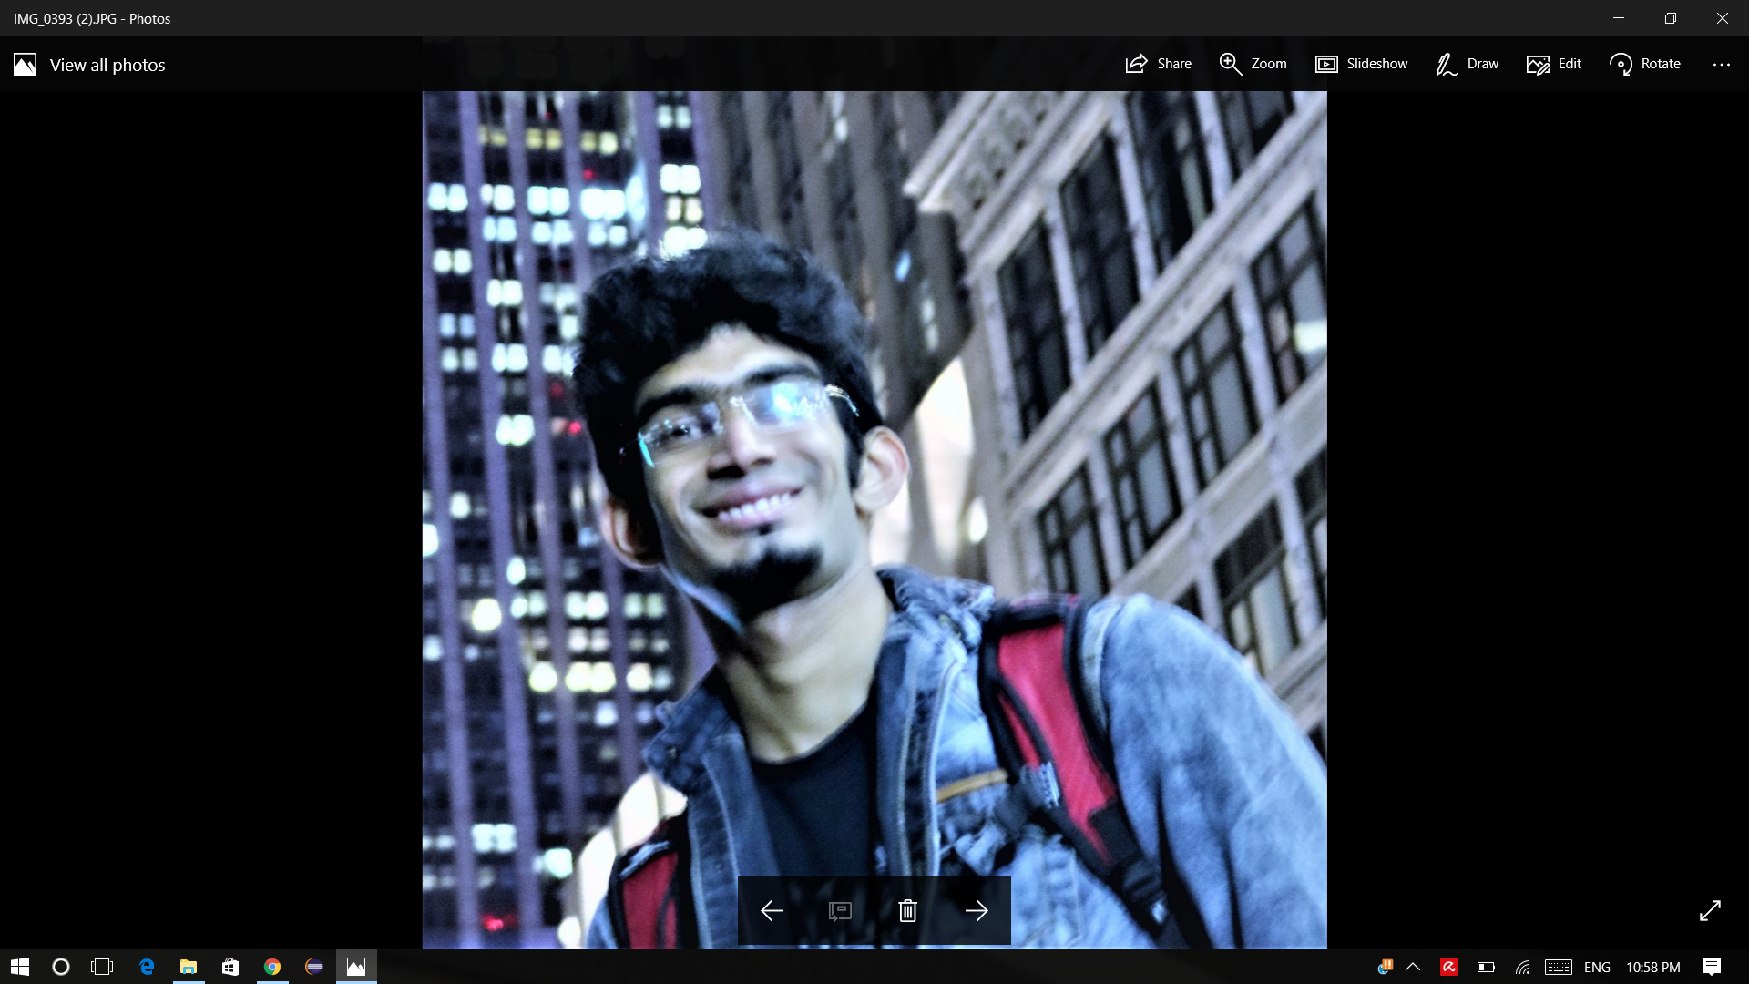
Learn One
Team
Jay Bakshi
Graduate Student Computer Science
jaybaksh@buffalo.edu
Ashutosh Jainvi
Graduate Student Computer Science
ajainvi@buffalo.edu
Ryan Gurian
Senior Mechanical Engineering
ryanguri@buffalo.edu
Yingkai Yang
Senior Mechanical Engineering
yingkaiy@buffalo.edu
Tushar Pavaskar
Graduate Student Electrical Engineering
tpavaska@buffalo.edu

Slide 39
Questions?

